Slide 1
Software Design and Architecture
Instructor: Ms. Sonia Rafaqat

Slide 2
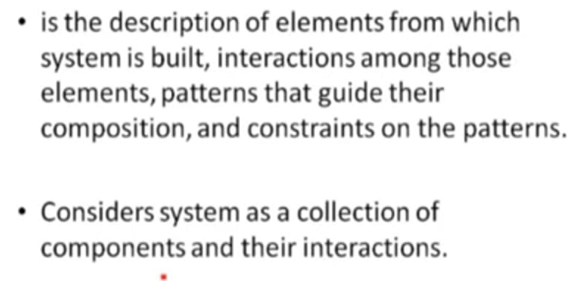
Software Architecture

Slide 3
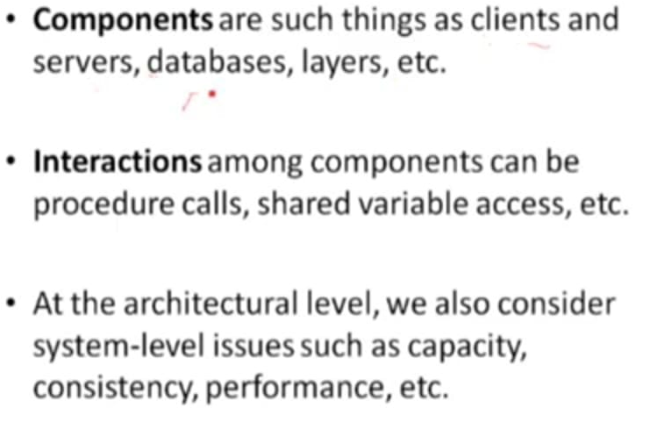
Components & their Interaction

Slide 4
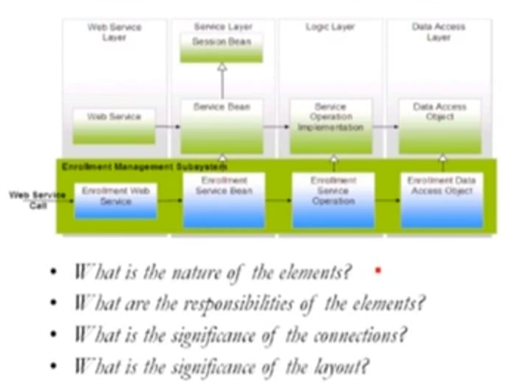
Software Architecture

Slide 5
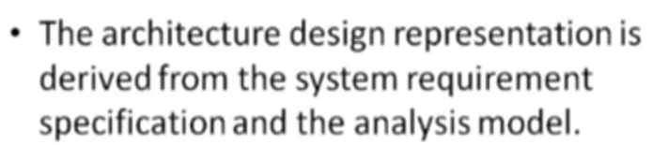
Where does architecture comes from?

Slide 6
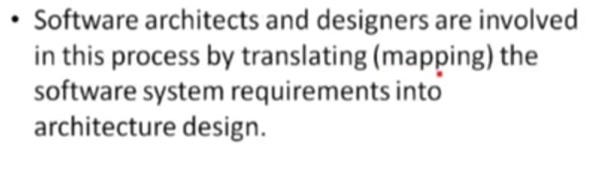
Who is responsible for developing the architecture?

Slide 7
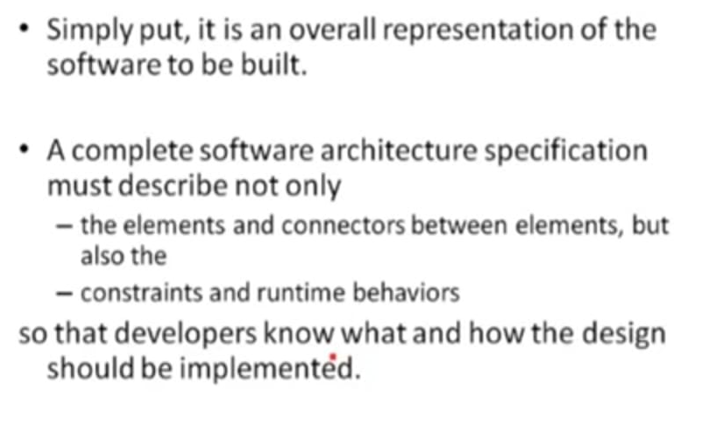
What is the outcomes of the software architecture?

Slide 8
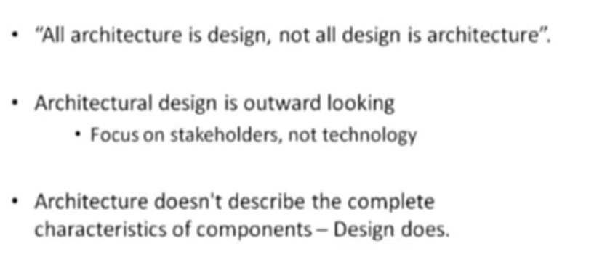
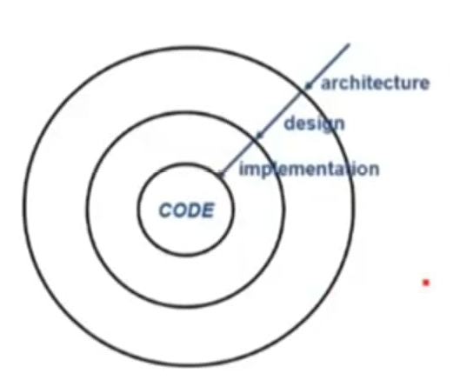
Architecture v/s Design

Slide 9
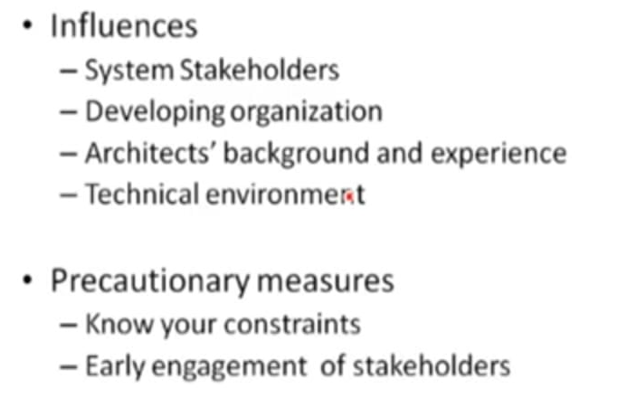
Architectural Influences

Slide 10
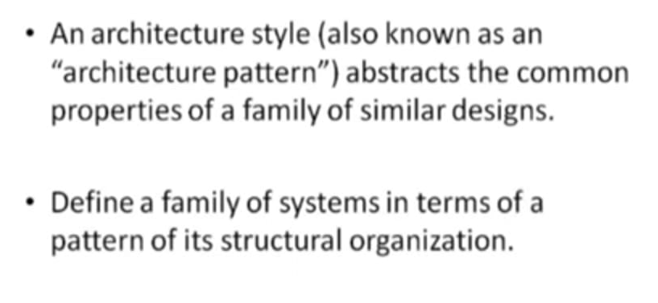
Architectural styles

Slide 11
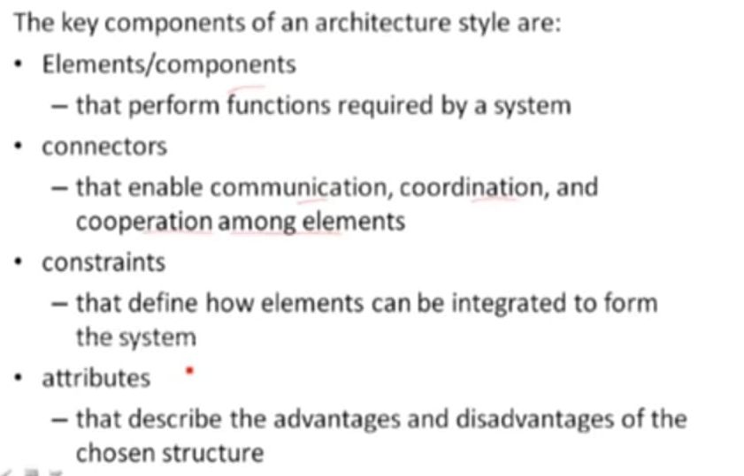
Architectural styles (Components)

Slide 12
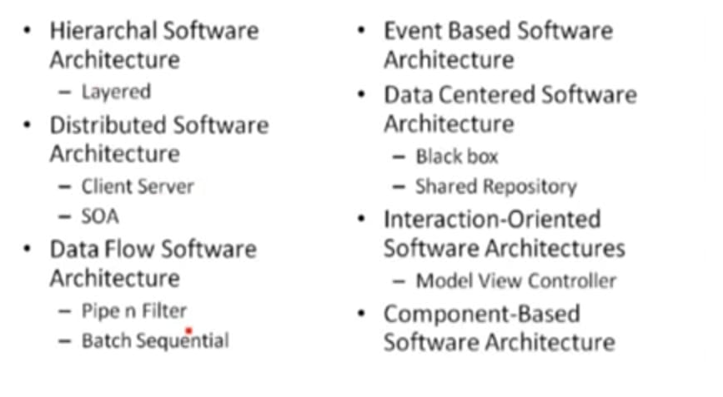
Categories of Architectural styles

Slide 13
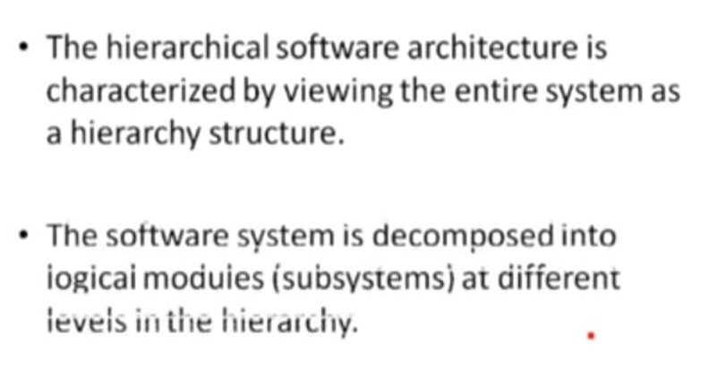
Hierarchal style

Slide 14
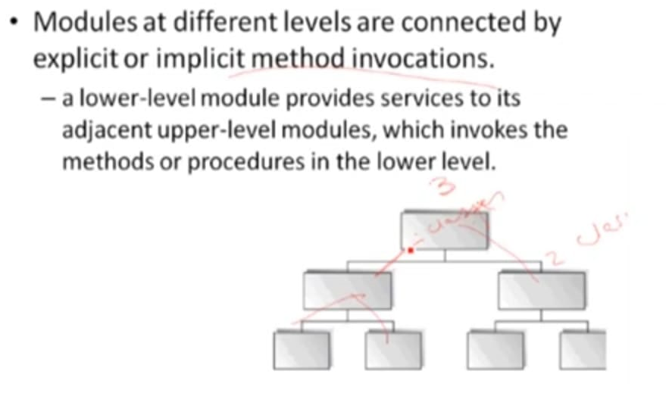
Hierarchal style

Slide 15
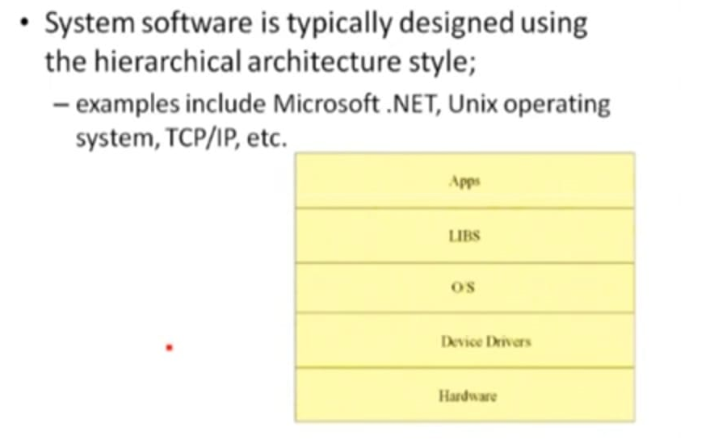
Hierarchal style

Slide 16
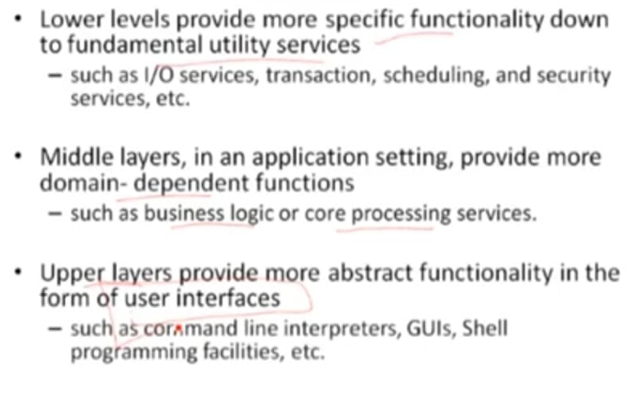
Hierarchal style

Slide 17
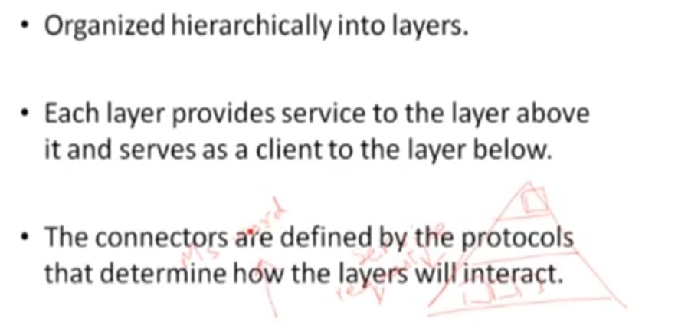
Hierarchal style (Layer style)

Slide 18
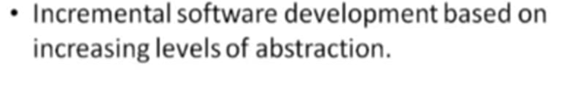
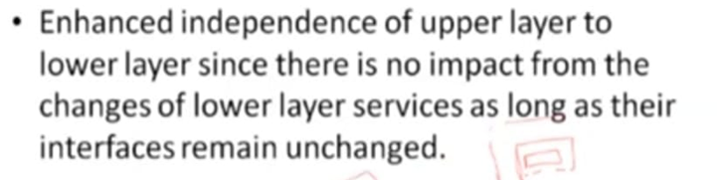
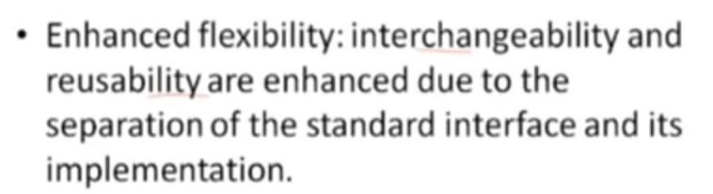
Hierarchal style (Benefits)

Slide 19
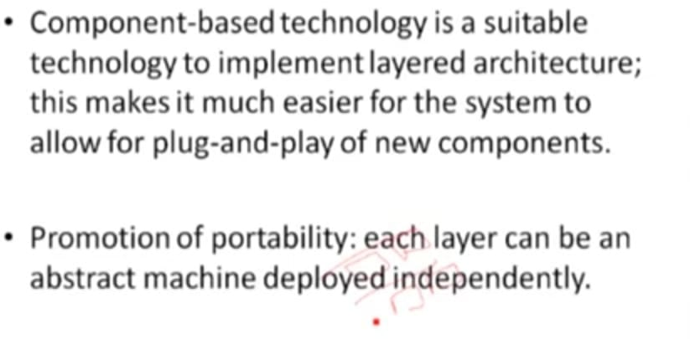
Hierarchal style (Benefits)

Slide 20
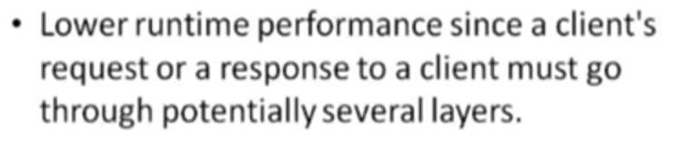
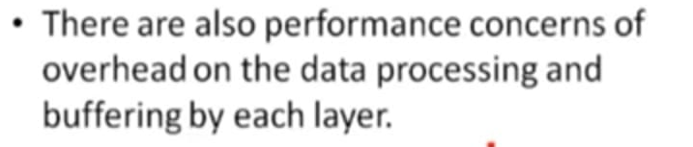
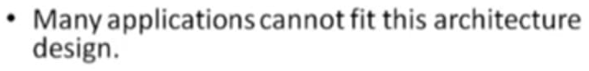
Hierarchal style (Limitations)

Slide 21
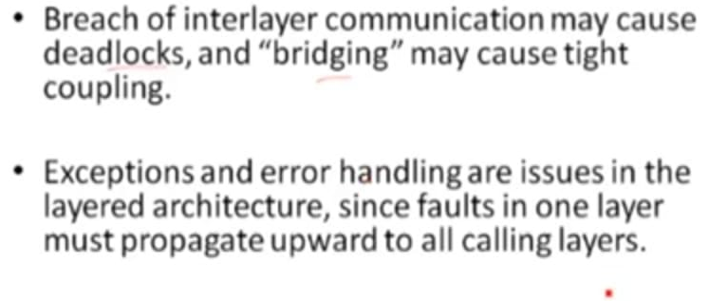
Hierarchal style (Limitations)

Slide 22
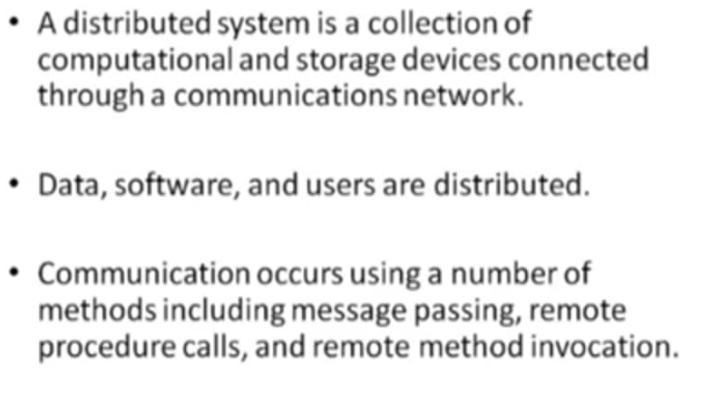
Distributed Software Architecture

Slide 23
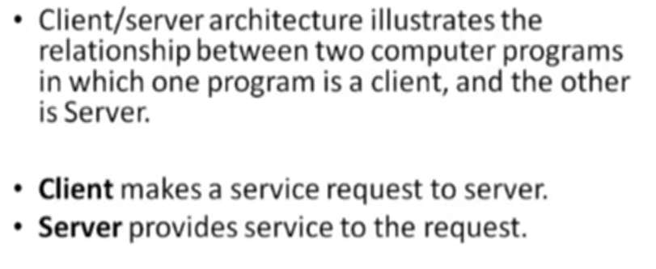
Distributed Software Architecture (Client Server Architectural Style)

Slide 24
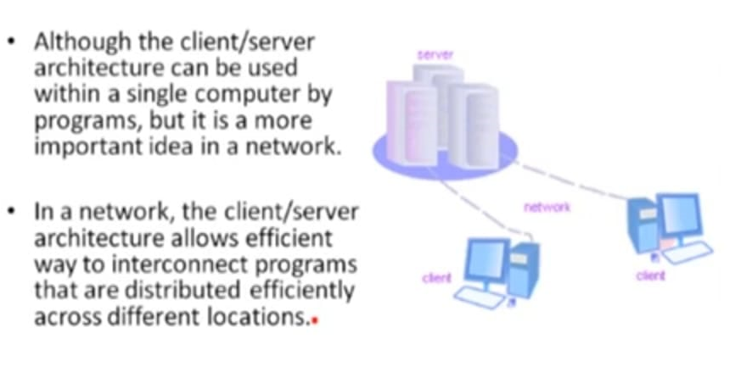
Distributed Software Architecture (Client Server Architectural Style)

Slide 25
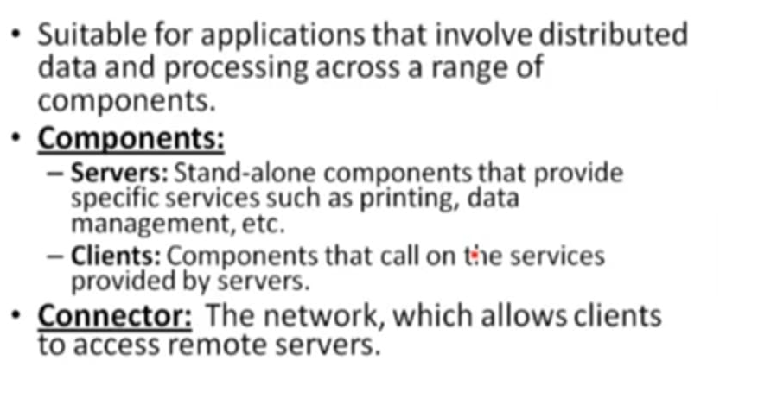
Distributed Software Architecture (Client Server Architectural Style)

Slide 26
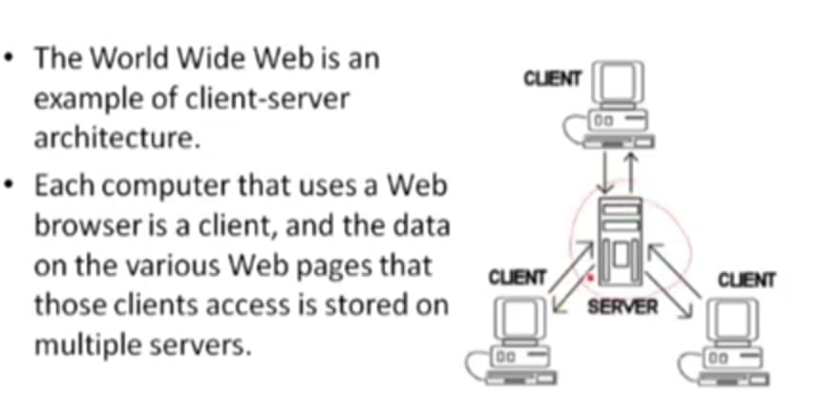
Distributed Software Architecture (Client Server Architectural Style)
Example #1

Slide 27
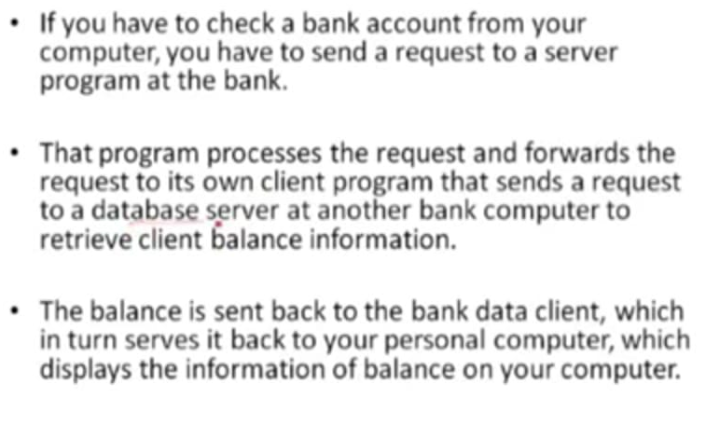
Distributed Software Architecture (Client Server Architectural Style)
Example #2

Slide 28
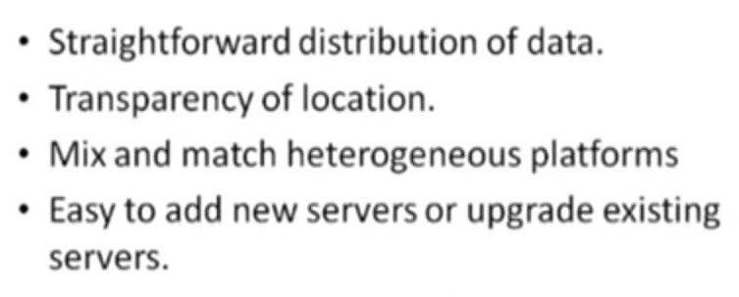
Distributed Software Architecture (Client Server Architectural Style)
Advantages

Slide 29
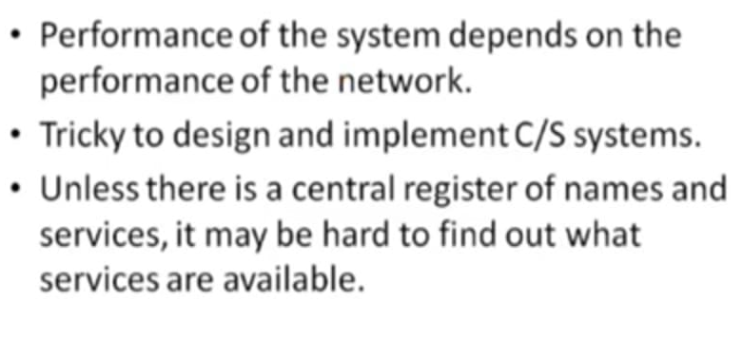
Distributed Software Architecture (Client Server Architectural Style)
Disadvantages

Slide 30
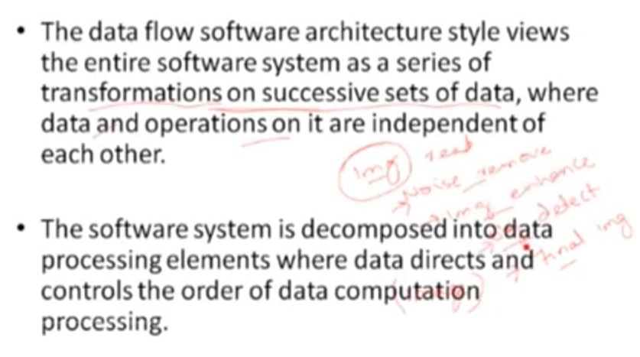
Data Flow Architectural style

Slide 31
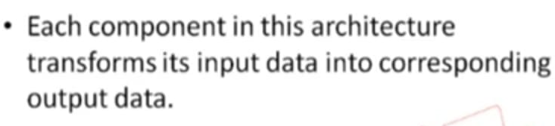
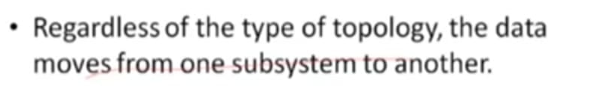
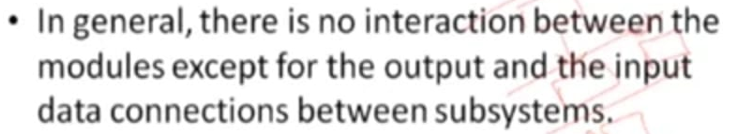
Data Flow Architectural style

Slide 32
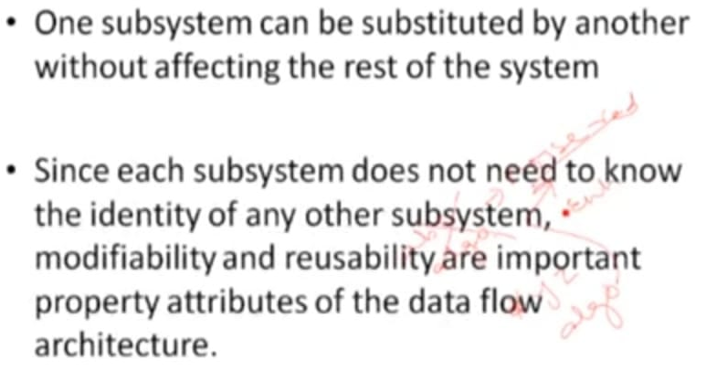
Data Flow Architectural style

Slide 33
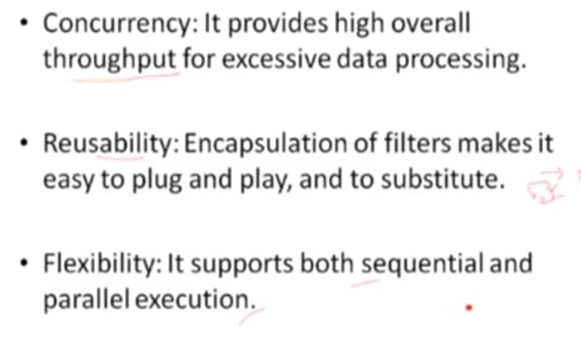
Data Flow Architectural style (Benefits)

Slide 34
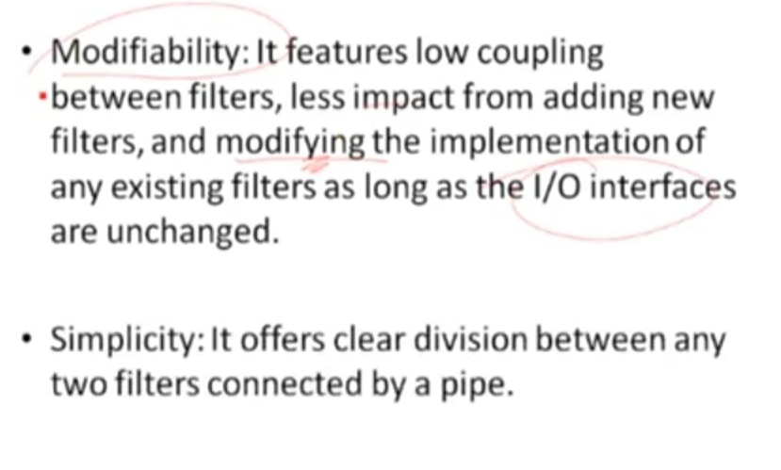
Data Flow Architectural style (Benefits)

Slide 35
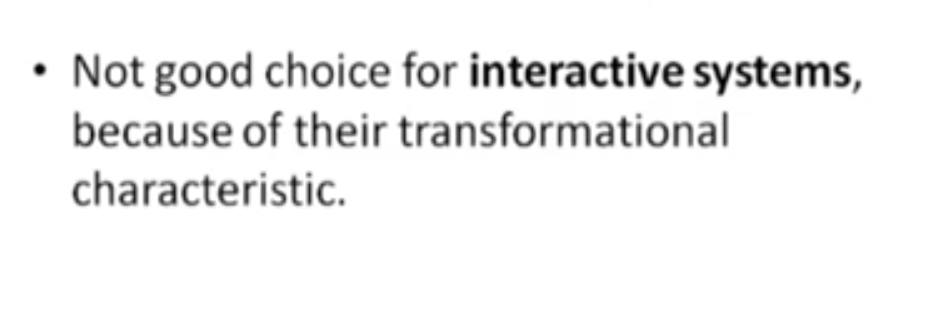
Data Flow Architectural style (Limitations)

